Slide 1
PROJECT
PRESENTATION
J.Akash
Notes:
PROJECT
PRESENTATION
J.Akash

Slide 2
DIGITAL PORTFOLIO
STUDENT NAME:
J.Akash
Register no:2428A0011
NM id:asbru262428a0011
Department:B.Sc Digital and Cyber Forensic science
College:Shri Nehru Maha Vidyalaya College of arts and science,Bharathiyar University
Notes:
Register no:2428A0011
NM id:asbru262428a0011
Department:B.Sc Digital and Cyber Forensic science
College:Shri Nehru Maha Vidyalaya College of arts and science,Bharathiyar University

Slide 3
AGENDA
1.Problem statement
2.Project Overviews
3.End Users
4.Tools and Technology
5.Portfolio design and Layout
6.Features and Functionality
7.Result and Screenshots
8. Con cl us i on
9.GitHub Link
Notes:
AGENDA
1.Problem statement
2.Project Overviews
3.End Users
4.Tools and Technology
5.Portfolio design and Layout
6.Features and Functionality
7.Result and Screenshots
8. Con cl us i on
9.GitHub Link

Slide 4
1.PROJECT OVERVIEW
A project overview is a high-level summary document that provide concise, one-page snapshot of a project's purpose, goals, scope, and expected outcomes. It serves as a communication tool to get all stakeholders aligned, a reference point for team members, and a document to secure buy-in from senior management by focusing on theproject's value, challenges, and objectives.

Slide 5
2.PORTFOLIO CONTAINS:
*. ABOUT ME
*. SKILLS
!.Hard Skills
!.Soft Skills
*. Hobbies
*. Languages
*. Certificate
*.C on ta ct
Notes:
*. ABOUT ME
*. SKILLS
!.Hard Skills
!.Soft Skills
*. Hobbies
*. Languages
*. Certificate
*.C on ta ct

Slide 6
3.MAIN IDEA
Creating a project involves defining clear objectivesandscope, identifying stakeholders, breaking the Prsiertintahaksana, milsstisningallien timeline, identifying and planning forpotential risks, and setting up communication channels forprogress tracking and stakeholder updates. A project planacts as a blueprint, guiding the project from initiationthrough execution tocompletionand eva lu at io n.

Slide 7
WHO ARE THE END USERS?
To effectively use student projects on a resume, create a Projects section or integrate them into the Education section Forprojects. Use bulletpoints to describeeach project with a action verb, include metrics and technologies, and skills relevant to the job you're applying for. Ensure you use clear, avoid jargon, and makeyourprojects easily understandable, possibly linking to them online if possible.

Slide 8
2.JOB SEEKERS PORTFOLIO
Job seekers should share a tailored resume, personalized messages, and their LinkedIn profile with recruiters, clearlystating the typeofrolethey are targeting and why they are are a good fit. Platforms like like Lin Linkedin allow job seekers to indicate their openness to new roles, directly signaling availability to recruiters. Whencontacting arecruiter, be professional, brief, highlight key qualifications, and express enthusiasm for the opportunity.9

Slide 9
3.F R EELA NC ER S
To showcase skills to clients, freelancers should build a portfolioof their workonplatformslike Notion, Behance, or Dribbble, and also market themselves on freelance marketplaces such as Upwork and Fiverr, by actively networking on platforms like Linkedin and Facebook groups, and by leveraging client referrals from their existing network.

Slide 10
TOOLS AND TECHNOLOGY
1.HTML:0HTMLstands for HyperText Markup Language. It is the standard language used to create and design web pages. HTML structures the content of a webpage using elements like headings, paragraphs, images, links, and tables. It is the backbone of all websites and works together withCSS andJavaScript to build complete web appl ic at io ns. 11

Slide 11
2.C S S:
CSS, or Cascading Style Sheets, is a stylesheet I ang u age used to define the visual presentation and layout of web pages. While HTML provides the structural foundation of a webpage, CSS is responsible for its aesthetic qu al it ies and how it appears to users.1

Slide 12
3.JAVA SCRIPT
JavaScript is aprogramming languageusedto makeweb pages interactive and dynamic. While HTML provides structure and CSS handles design, JavaScript adds ids functionality -such as form validation, animations, image sliders, pop-up messages, and interactive buttons.It iswidelyusedinwebdevelopmenttocreate responsive and user-friendly websites and applications. 13

Slide 13
PORTFOLIO DESIGN AND LAYOUT
Sections included: *.H ome; My self Hobby cer ti fic at e Skills: *.Hard Skills *.Soft Skills Contact: *. Em ail Address Contact Numb
Notes:
Sections included: *.H ome; My self Hobby cer ti fic at e Skills: *.Hard Skills *.Soft Skills Contact: *. Em ail Address Contact Numb

Slide 14
Futures and Functionality
*Futures and Functionality* refers to the pot en ti alfuture developments and features that a product, system, ortechnologymightincorporateto enhance its capabilities, performance, or user experience.This concept is often explored in technology, product design, and strategic planning.

Slide 15

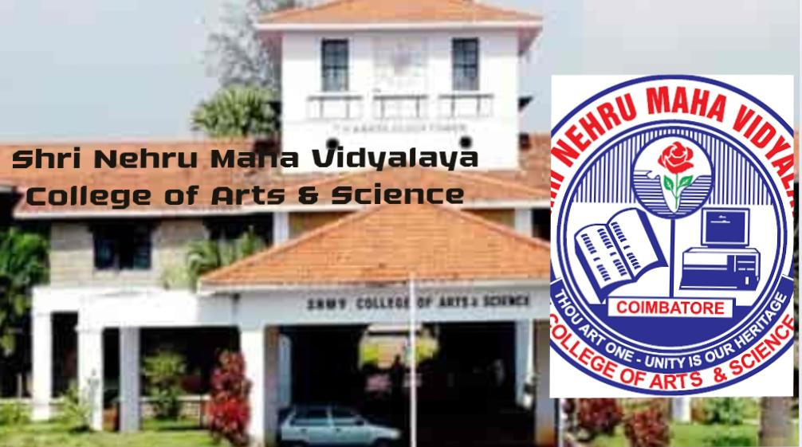
RESULT AND SCREENSHOTS

Slide 16

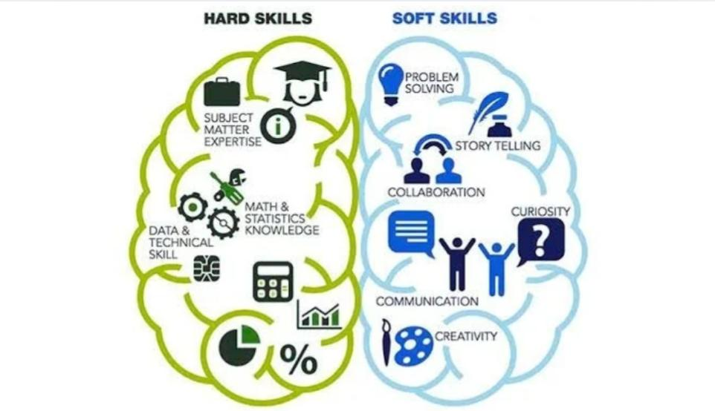
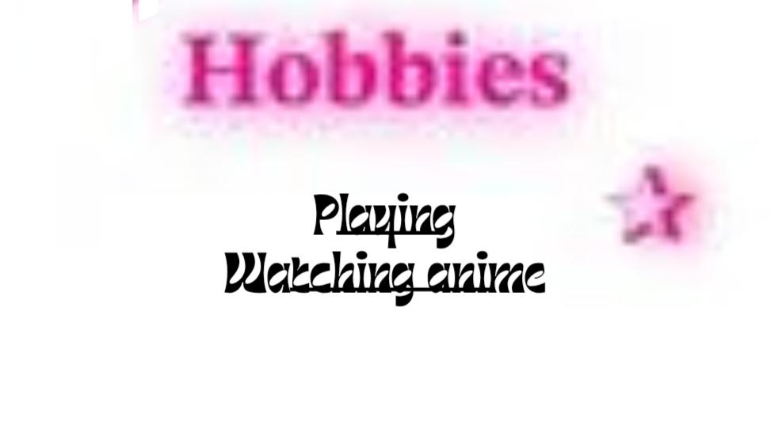

Slide 17

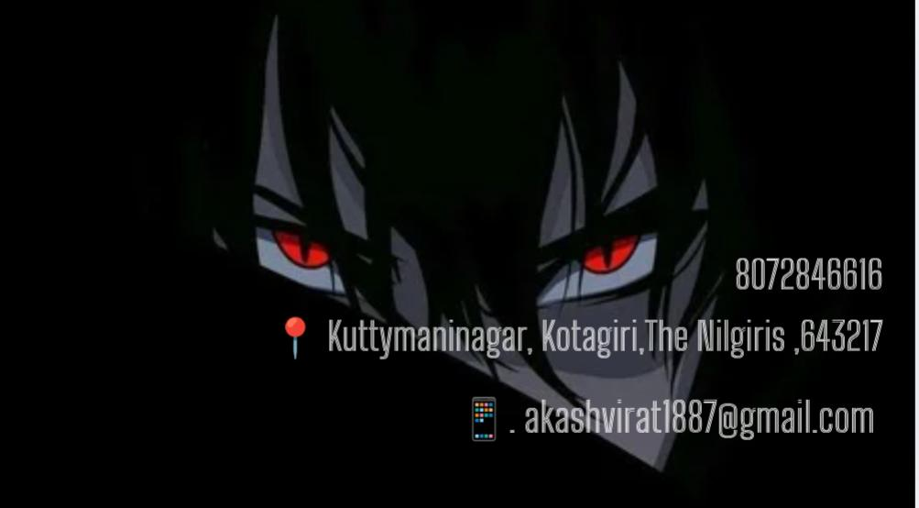


Slide 18
CONCLUSION
1. Clear objectives and goals 2. Practical application of knowledge 3. Innovation and creative problem-solving 4. Modern tools and technology 5. Effective teamwork and communication 6. Measurableachievements and impact These elements drive project success, innovation, and g ro wt h. 19
Notes:
1. Clear objectives and goals 2. Practical application of knowledge 3. Innovation and creative problem-solving 4. Modern tools and technology 5. Effective teamwork and communication 6. Measurableachievements and impact These elements drive project success, innovation, and g ro wt h. 19

Slide 19
FINAL SUMMARY
This project has been a valuable learning experience that enhanced my knowledge, skills, and creativity. It helpedmeapply theoretical conceptsin practicalways and strengthened my concepts in practical wa problemsolving and teamwork abilities. Overall, the projec treflects my dedication, hard work, and interest in continuouslearning, which willsupportmyfuture academic and professional growth

Slide 20
Benefits of Society
This project contributes positively to society by providing practical solutions and spreading awareness. It is designed to improve knowledge, promote innovation, and create value that can help people in their daily lives. The project reflects social responsibility and aims to make a meaningful impact on the community

Slide 21
THE END
8072846616
✉️. akashnm289@gmail.com
📍.shri nehru maha vidyalaya college of arts and science, coimbatore
Notes:
8072846616
✉️. akashnm289@gmail.com
📍.shri nehru maha vidyalaya college of arts and science, coimbatore

Slide 22
THANK YOU
Notes:
THANK YOU

